Slide 1



Applied Data Analysis (CS401)
Lecture 2
Handling data
27 Sep 2023
Robert West
Notes:
2020: Overall, 8 minutes too long. 2-3 min of tech difficulties in the beginning. “Dirty data horror stories”: told only CHF 10k anecdote. Skipped Willy slide. Gave quick version of reCAPTCHA slide. Part 1 took exactly 45 min (incl. tech difficulties in the beginning), did break then
2021: Timing good (1-2 min overtime; regular 15-min break)
2023: 4 minutes too long (15-min break; skipped slides 57-58)

Slide 2
Announcements
Register your teams (5 people) here by Fri 6 Oct
Each team member must individually complete the form!
Project milestone P1 to be released this Fri, due Fri 13 Oct
First quiz (“Q1”*) to be held in this Friday’s lab session
Test run, to make sure everything works smoothly
Won’t count towards grade
Friday’s lab session:
Intro to Pandas (very important for Homework H1 and rest of course)
* Remember: Qi is always about material from week i.

Slide 3
Feedback
Give us feedback on this lecture here: https://go.epfl.ch/ada2023-lec2-feedback
Feedback form available for each lecture and lab session
What did you (not) like about this lecture?
What was (not) well explained?
On what would you like more (fewer) details?
Is it nicer to follow the lecture online or offline?
…

Slide 4
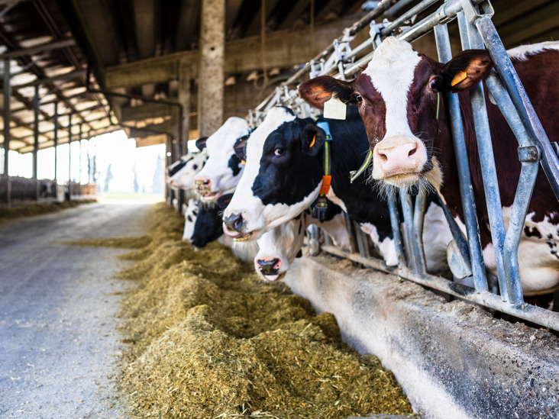
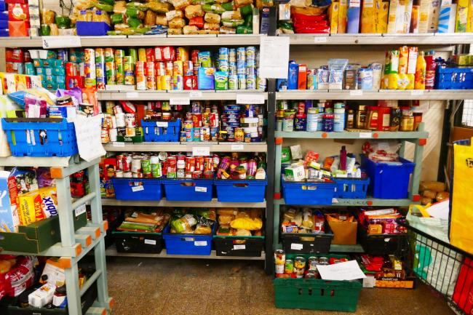
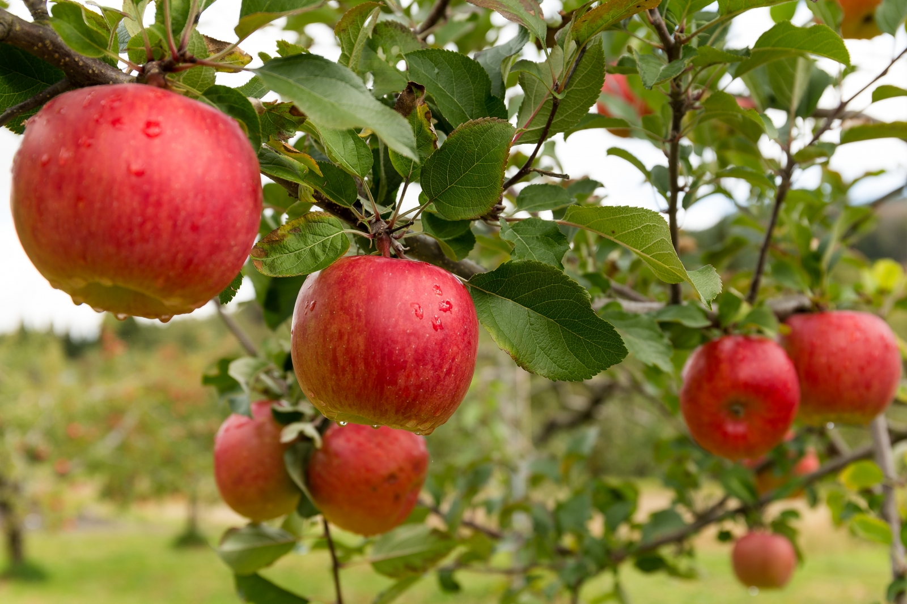
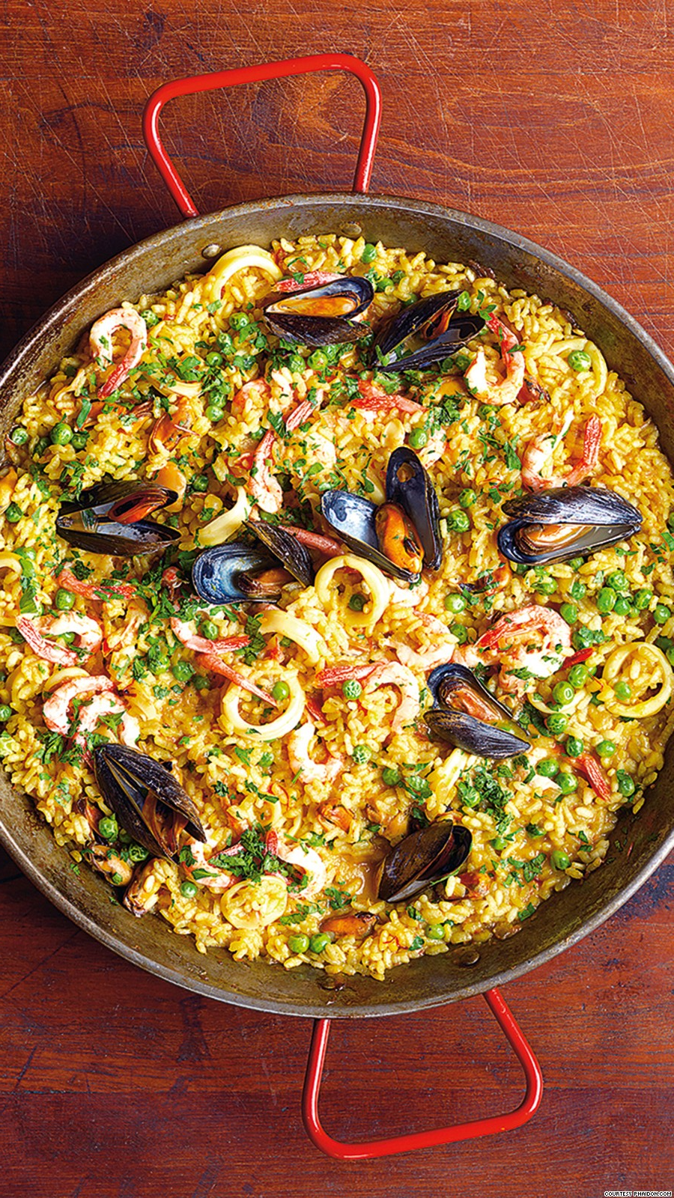
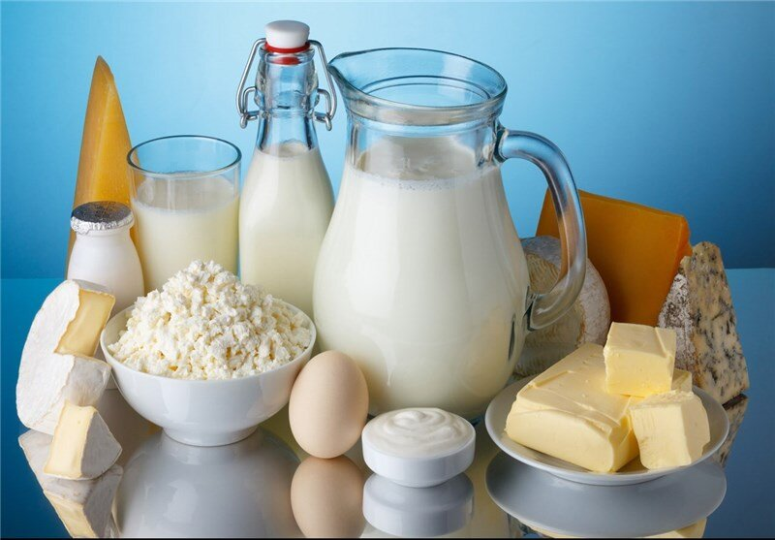
Cooking with data
Part 2:
Data sources
Part 1:
Data models
Part 3:
Data wrangling
Notes:
Data science a bit like cooking
You start from raw ingredients and turn them into something useful: a delicious meal / insights
Cooking: cumbersome to go to the field and pick apples, or milk/slaughter a cow, every time you want to cook a meal
Instead: [CLICK] go to store where ingredients are systematically shelved or even partially preprocessed
Same for data: don’t always go back to raw data, but organize it in useful formats that can then serve as input to various downstream analyses
“Data warehouse”
Today: 3 parts
1: how to represent data (conceptually as well as on a computer): data models
…

Slide 5
Cooking with data
Part 2:
Data sources
Part 1:
Data models
Part 3:
Data wrangling

Slide 6
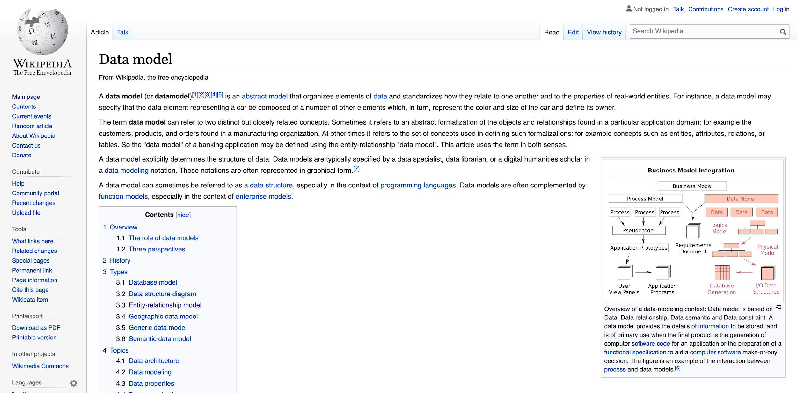
Bob’s definition: A data model specifies how you think about the world
Notes:
…
What aspects of the world do you want to take into account?
E.g., data scientist at FB: world is a set of people connected via symmetric friendship links
What properties of those people do you care about? Gender? Age? Shoe size?
Your choice as the data modeler!
E.g., Twitter: links are not symmetric

Slide 7
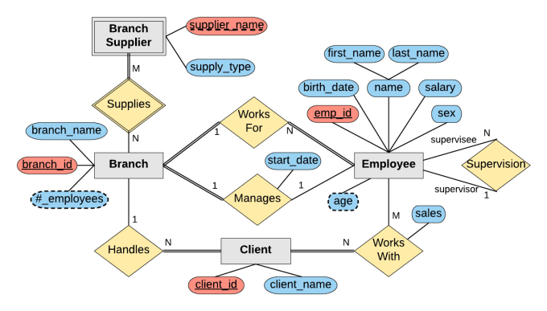
Q: “How do you think about the world?”
A: “See my entity–relationship diagram!”
entity
Part 1:
Data models
relationship
attributes
Notes:
As mentioned, data model specifies how you think about the world
And when someone asks you how you think about the world, a good way to answer is by showing them an ER diagram
Here a reminder from your DB class, if you’ve taken one
(Who has seen ER diagrams?)
Model of a company
Gray rectangles: entities
Yellow rhombi: relationships (with cardinalities)
Blue/red pills: attributes (for both entities and relationships; red: keys)

Slide 8
Q: “How do you think about the world?”
A: “See my entity–relationship diagram!”
How to store my data on a computer?
entity
Part 1:
Data models
relationship
attributes
Notes:
ER diagram is abstract, conceptual
Orthogonal: how to store on a computer

Slide 9
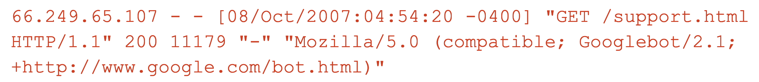
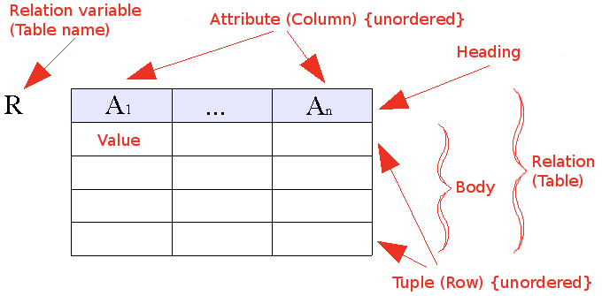
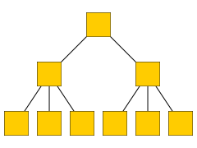
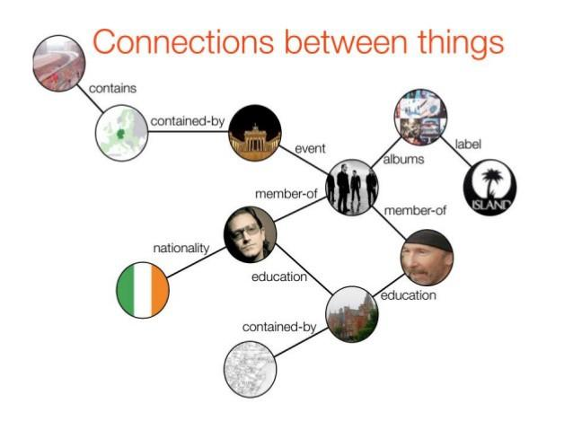
Q1: “How should I store my data on a computer?”
Q2: “How do I think about the world?”
“The world is simple: one type of entity, all with the same attributes” → Flat model
“The world contains many types of entities, connected by relationships” → Relational model
“The world is a hierarchy of entities” → Document model
“The world is a complex network of entities” → Network model
Notes:
…
They are equivalent, can represent any dataset in any model
But processing the data is vastly simplified by representing the data in the most appropriate model

Slide 10
Flat model
Example: log files; e.g., Apache web server (httpd)
Entities = requests from clients to server
66.249.65.107 - - [08/Oct/2007:04:54:20 -0400] "GET /support.html HTTP/1.1" 200 11179 "-" "Mozilla/5.0 (compatible; Googlebot/2.1; +http://www.google.com/bot.html)"
111.111.111.111 - - [08/Oct/2007:11:17:55 -0400] "GET / HTTP/1.1" 200 10801 "http://www.google.com/search?q=in+love+with+ada+lovelace+what+to+do&ie=utf-8&oe=utf-8&aq=t&rls=org.mozilla:en-US:official&client=firefox-a" "Mozilla/5.0 (Windows; U; Windows NT 5.2; en-US; rv:1.8.1.7) Gecko/20070914 Firefox/2.0.0.7"
Another common format: CSV (“comma-separated vector”)
Notes:
“d” in “httpd” for “daemon”
Not a real DB (no schema, no consistency), although it looks temptingly like one
~ benevolently formatted plain text
Although Apache logs a bit painful…
CSV

Slide 11
Q1: “How should I store my data on a computer?”
Q2: “How do I think about the world?”
“The world is simple: one type of entity, all with the same attributes” → Flat model
“The world contains many types of entities, connected by relationships” → Relational model
“The world is a hierarchy of entities” → Document model
“The world is a complex network of entities” → Network model

Slide 12
Relational model
“The world contains many types of entities, connected by relationships”
The relational model is ubiquitous:
MySQL, PostgreSQL, Oracle, DB2, SQLite, …
You use it many times every day
Data represented as tables describing
entities,
relationships between entities
id | name
1 | Bush
2 | Trump
3 | Obama
president | successor
1 | 3
3 | 2

Slide 13
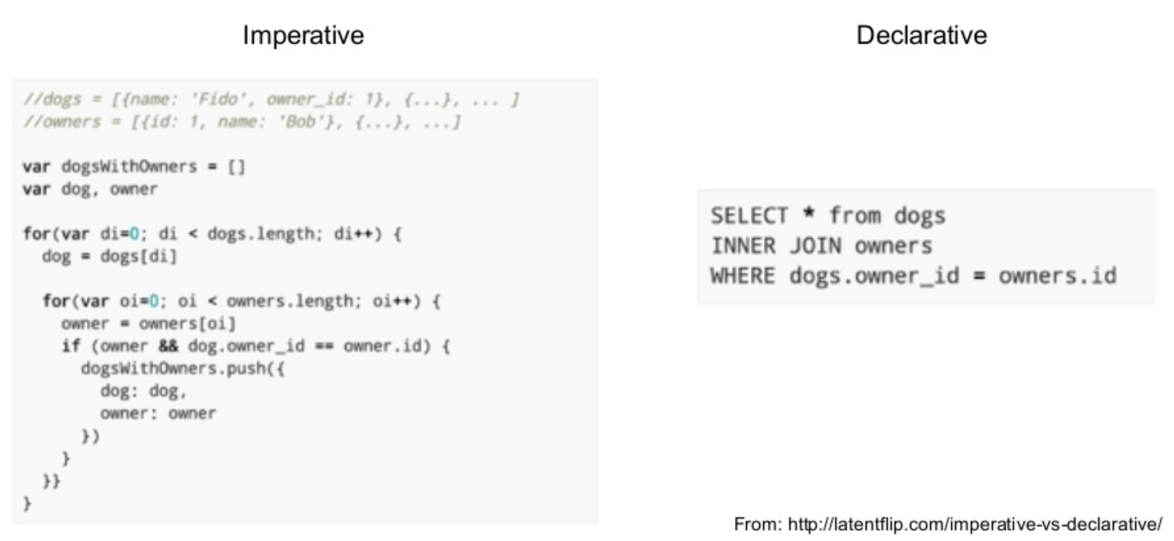
Processing data in the relational model: SQL
Declarative language for core data manipulations
You think about what you want, not how to compute it
Notes:
SQL = structured query language
The interface for doing stuff with relational data
Extremely rich language; a lot of fun to puzzle together massive queries
…
Example:
Have: table w/ owner names and ids, table w/ dog names and owner ids
Want: table w/ dog names and owner names
Need to join info from both tables

Slide 14
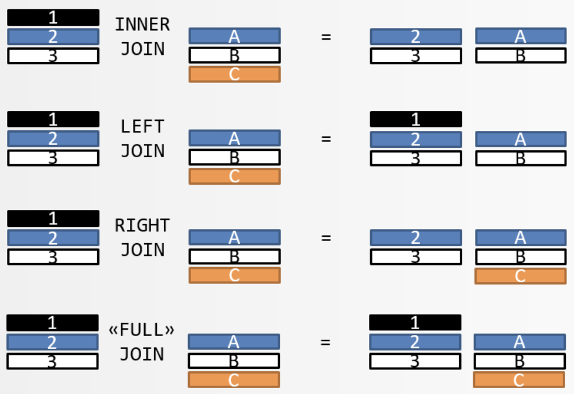
SQL
You should know basics of SQL
Need a refresher? → Watch/do online tutorials!
Key operations:
Select (!), update, delete
Unique keys
Joins (inner, left outer, right outer, full)
Sorting
Aggregation (group by, count, min, max, avg, etc.)
Notes:
If you haven’t taken a DB class: no big deal – but you should know at the very least about these few key SQL concepts
So at the very least, learn/revise about those

Slide 15


POLLING TIME
“Have you worked with SQL joins?”
Scan QR code or go to https://web.speakup.info/room/join/66626
Notes:
Have you worked with SQL joins? (Check all that apply.)
(A) Yes, I’ve used INNER JOIN.
(B) Yes, I’ve used LEFT JOIN or RIGHT JOIN.
(C) I’ve heard of joins, but haven’t used them.
(D) I have no clue what you’re talking about.

Slide 16
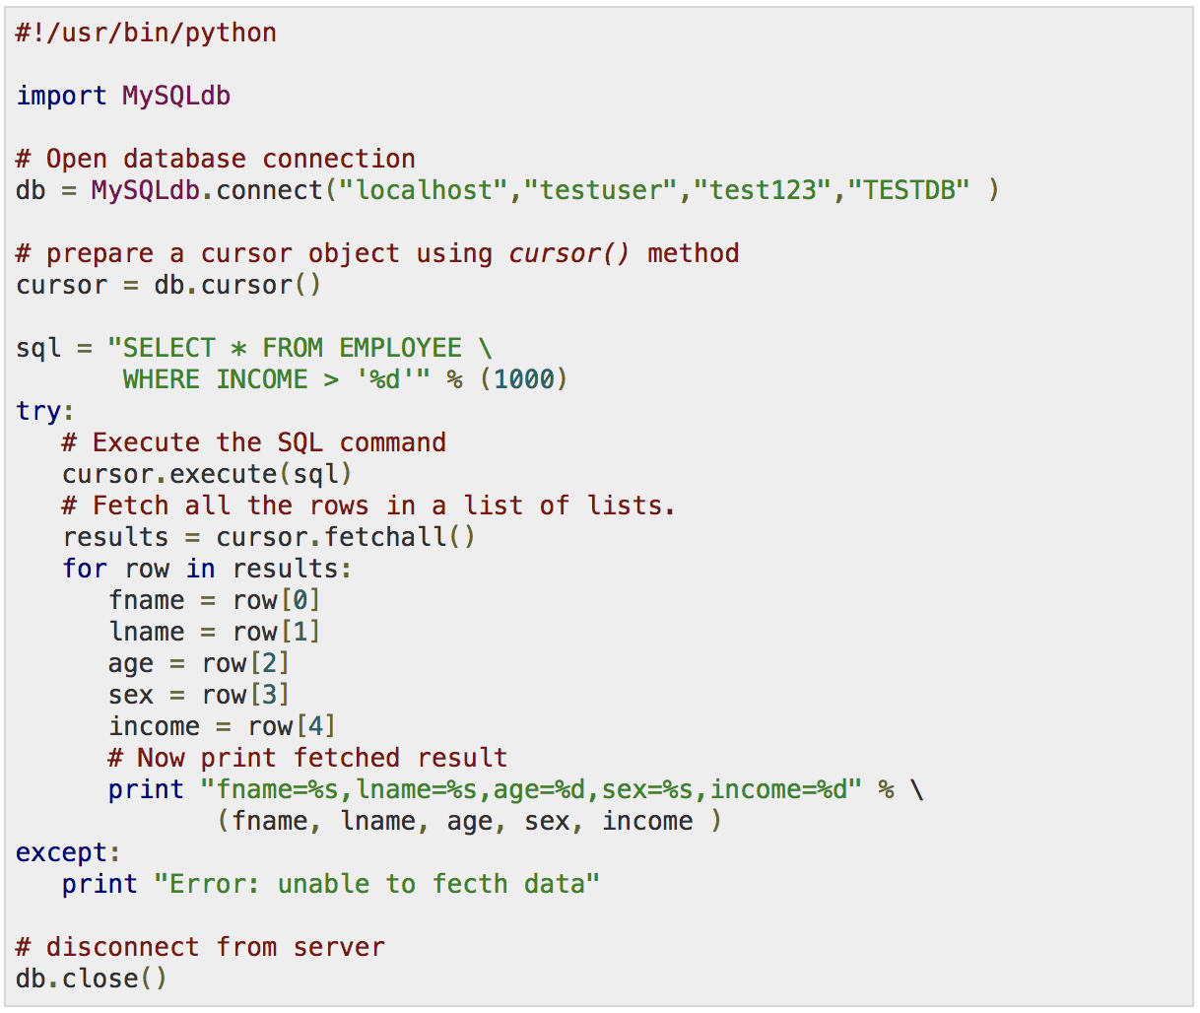


SQL implementations
etc.
Notes:
SQL is abstract (math). Many implementations.
There are command line clients and GUIs
but often most convenient: call from another PL (e.g., Python)

Slide 17
SQL and “SQL”
The declarative-programming principles of SQL are widespread, even where it’s less obvious
Notes:
The declarative-programming principles of SQL are widespread
Spirit of SQL can be found in many places, even where it’s less obvious
I refer to such cases as “SQL” in quotation marks, as opposed to real SQL

Slide 18
“SQL”: Pandas (Python library)
Similar to SQL (declarative), with additional elements of functional programming (map(), filter(), etc.)
SQL “table” ←→ Pandas “DataFrame”
Need intro? Come to Friday’s lab session!

Slide 19
Pandas vs. SQL
+ Pandas is lightweight and fast
+ Natively Python, i.e., full SQL expressiveness plus the expressiveness of Python, especially for function evaluation
+ Integration with plotting functions like Matplotlib
- In Pandas, tables must fit into memory
- No post-load indexing functionality: indices are built when a table is created
- No transactions, journaling, etc. (matters for parallel applications)
- Large, complex joins are slower

Slide 20
“SQL”: Unix command line
Goal: Find top 5 URLs visited most frequently by users between 18 and 35 years old
user_id age
User145 33
User24 15
User5 76
…
user_id url
User2 ada.epfl.ch
User244 facebook.com
…
cat users.txt \
| awk ‘$2 >= 18 && $2 <= 25’ \
| join -1 1 -2 1 url_visits.txt - \
| cut -f 4 \
| sort \
| uniq -c \
| sort -k 1,1 -n -r \
| head -n 5
Notes:
Have: 2 files, each w/ 2 cols
users.txt: (userid, age), one row per user
url_visits.txt: (userid, url), one row per visit
Want: find top 5 URLs visited most frequently by users between 18 and 35 yo
This one-line UNIX command does the job
Don’t underestimate its power
It works on Macs
Free afternoon? Read a tutorial

Slide 21
Q1: “How should I store my data on a computer?”
Q2: “How do I think about the world?”
“The world is simple: one type of entity, all with the same attributes” → Flat model
“The world contains many types of entities, connected by relationships” → Relational model
“The world is a hierarchy of entities” → Document model
“The world is a complex network of entities” → Network model

Slide 22
Document model
contact
address
“The world is a hierarchy of entities”
street,
city,
country
XML format:
JSON format:
<contact> <id>656</id> <firstname>Chuck</firstname> <lastname>Smith</lastname> <phone>(123) 555-0178</phone> <phone>(890) 555-0133</phone> <address> <street>Rue de l’Ale 8</street> <city>Lausanne</city> <zip>1007</zip> <country>CH</country> </address> </contact>
contact: { id: 656, firstname: “Chuck”, lastname: “Smith”, phones: [“(123) 555-0178”, “(890) 555-0133”], address: { street: “Rue de l’Ale 8”, city: “Lausanne”, zip: 1007, country: “CH” } }
Notes:
Ex.: contacts in an address book (contact has addresses, addresses consist of …)
Both formats equivalent; but JSON usually easier to read for humans
XML: nested tags
JSON: set of key/value pairs
Keys: strings
Values:
Leaves: primitive types: strings, number, boolean
JSON object (recursive! → tree), e.g., “address”
Arrays of JSON objects (or strings/numbers/booleans); e.g., “phones”

Slide 23
Think for a minute:
If we want to use a relational DB (e.g., MySQL)
instead of XML, how can we store
several phone numbers for the same person?
(Feel free to discuss with your neighbor.)
Document model
<contact> <id>656</id> <firstname>Chuck</firstname> <lastname>Smith</lastname> <phone>(123) 555-0178</phone> <phone>(890) 555-0133</phone> <address> <street>Rue de l’Ale 8</street> <city>Lausanne</city> <zip>1007</zip> <country>CH</country> </address> </contact>
Notes:
Don’t know a priori how many phone numbers a person might have; may differ across people; no upper bound

Slide 24
Solution to “Think for a minute”
Document model
Same in relational model
<contact> <id>656</id> <firstname>Chuck</firstname> <lastname>Smith</lastname> <phone>(123) 555-0178</phone> <phone>(890) 555-0133</phone> <address> <street>Rue de l’Ale 8</street> <city>Lausanne</city> <zip>1007</zip> <country>CH</country> </address> </contact>
id | first name | ...
656 | Chuck | ...
... | ... | ...
id | phone
656 | (123) 555-0178
656 | (890) 555-0133
... | ...
Notes:
Relational: same entity may be spread across tables
doc model: all together
by allowing for repetitions, whereas in relational model, we can’t have a variable #cols
Different models are better suited for different kinds of processing
E.g., updating easier in doc model, since not spread out
Relationships between different entities (e.g., friendship) more easily expressed in relational model (via explicit table listing pairs of keys/IDs of related entities)

Slide 25
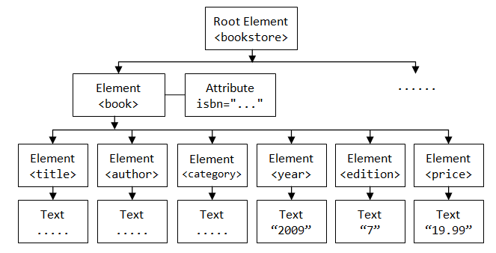
Processing XML and JSON
Document structure = tree
Processing via tree traversal (depth- or breadth-first search)
Or use proper query language, such as XQuery or jq

Slide 26
Q1: “How should I store my data on a computer?”
Q2: “How do I think about the world?”
“The world is simple: one type of entity, all with the same attributes” → Flat model
“The world contains many types of entities, connected by relationships” → Relational model
“The world is a hierarchy of entities” → Document model
“The world is a complex network of entities” → Network model

Slide 27
Network model
“The world is a complex network of entities”
Notes:
Model =~ how you think about the world
Models data as vertices and edges
Could also be written as tables as in relational model
But network model additionally comes with query language that lets you succinctly express graph relations
E.g., find path between Ireland and Island Records
(impossible in SQL)
We’ll see example later (Wikidata KG)

Slide 28
“How should I store my data on a computer?”
—A word (or two) on binary formats
“Parsing” = converting strings (as stored in text files) to data types used by computer programs (e.g., int, float, boolean, array, list)
Possibly expensive, but can be avoided by using binary formats: store data to disk “as is”, without first converting to strings
Modern binary formats support nested structures, various levels of schema enforcement, compression, etc.
Python pickle, Java Serializable, Protocol Buffers (Google), Avro (supports schema evolution), Parquet (column-oriented), etc.
→ Consider converting to a binary format at the beginning of your processing pipeline (especially when using “big data”)
Notes:
Parsing == going from plain text to binary format

Slide 29

Commercial break
ADA: more than just rocket science!

Slide 30
Cooking with data
Part 2:
Data sources
Part 1:
Data models
Part 3:
Data wrangling

Slide 31
Data sources at Web companies
Examples from Facebook
Application databases
Web server logs
Client-side event logs
API server logs
Ad server logs
Search server logs
Advertisement landing page content
Wikipedia
Images and video
Structured data (with clear schema)
Semi-structured data
(“self-describing” structure; CSV etc.)
Unstructured data
Notes:
(Order: structured → unstructured → semi-structured)
DB: constraints between tables, so everything is always nicely consistent
More structured is usually preferable, if possible
Cooking analogy: If you can go and pick ingredients from someone else’s shelves, or buy them in the store → great!
Much of the work done already by others
But when combining multiple sources, need to harmonize format → need to think about data models again
Sometimes need to go get your own data from the wild, unstructured world

Slide 32

Another example: Wikipedia
300+ languages
42 million entities
Mind-boggling richness of data

Slide 33
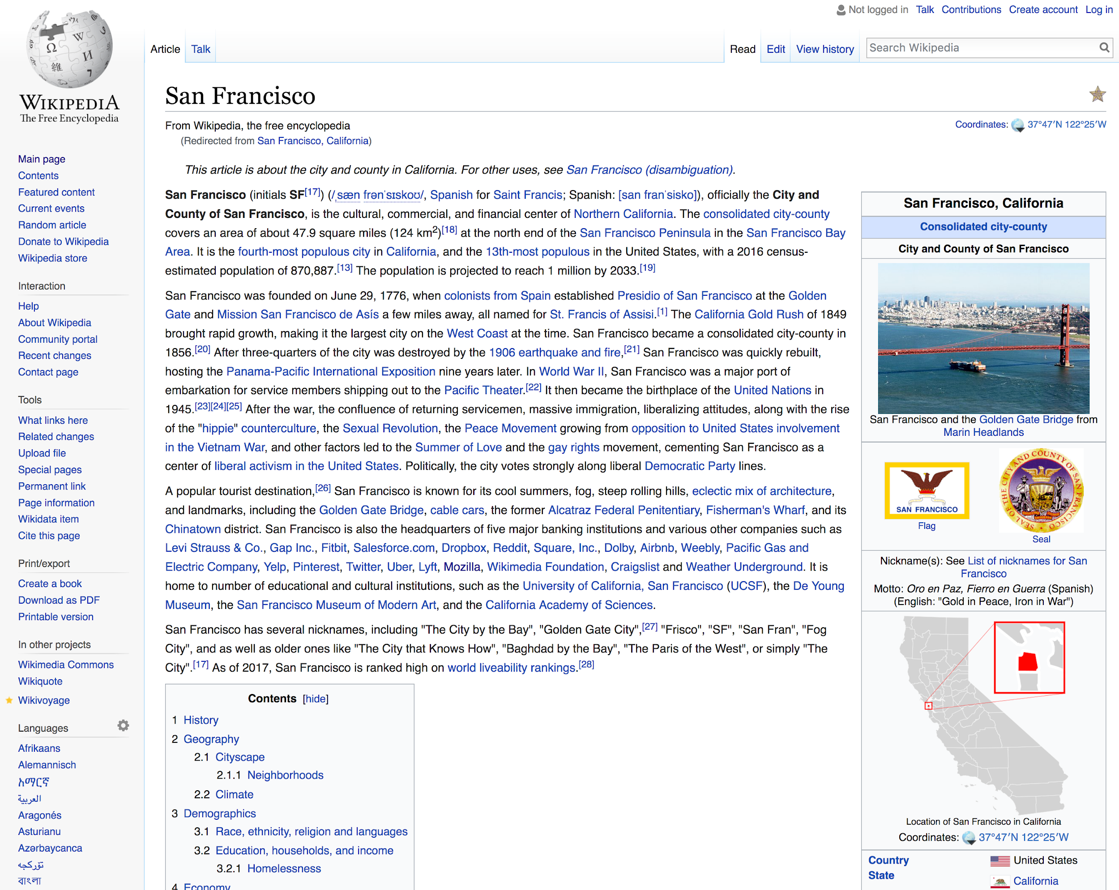
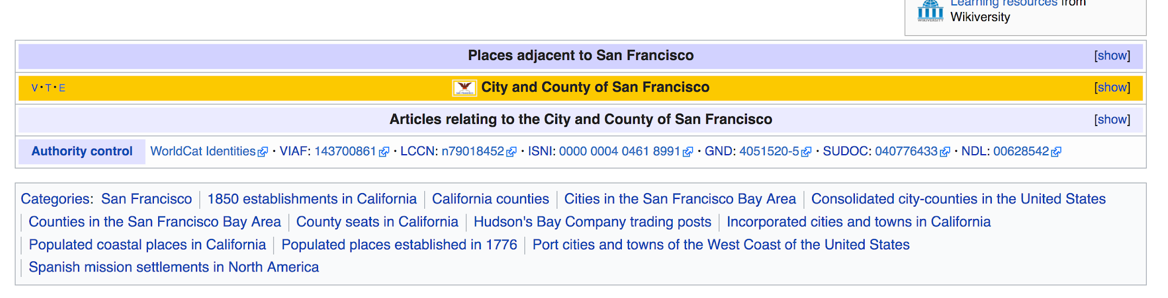

link

Slide 34
Wikipedia
How to work with Wikipedia?
REST (cf. later) API
XML dumps with wiki markup, SQL database dumps
Issues: Unicode, size, recency, etc.
To make your life easier:
Find projects on GitHub to help you
Use more structured versions (p.t.o.)

Slide 35
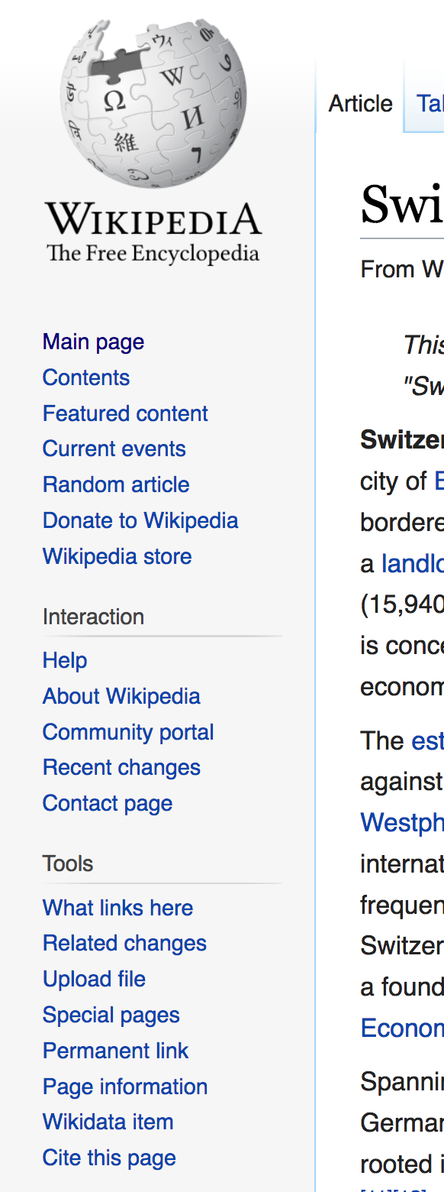
Wikidata
“Database version” of Wikipedia
{fr:Suisse, de:Schweiz, it:Svizzera, en:Switzerland, …} → Q39
Notes:
Whether you click “Wikidata item” from fr, de, it, en, …, wiki, you’ll always get to Q39

Slide 36
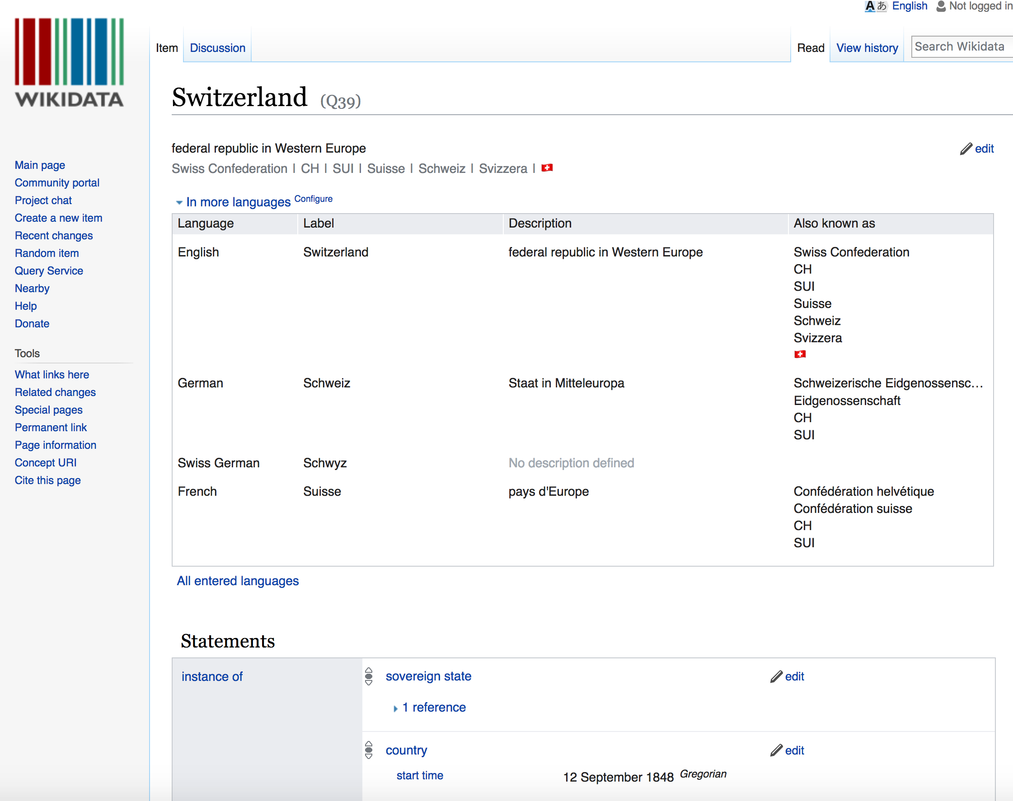

Slide 37
Wikidata
“Database version” of Wikipedia
{fr:Suisse, de:Schweiz, it:Svizzera, en:Switzerland, …} → Q39
Both API access and full database dumps
Available as
JSON (document model)
RDF (network model)

Slide 38
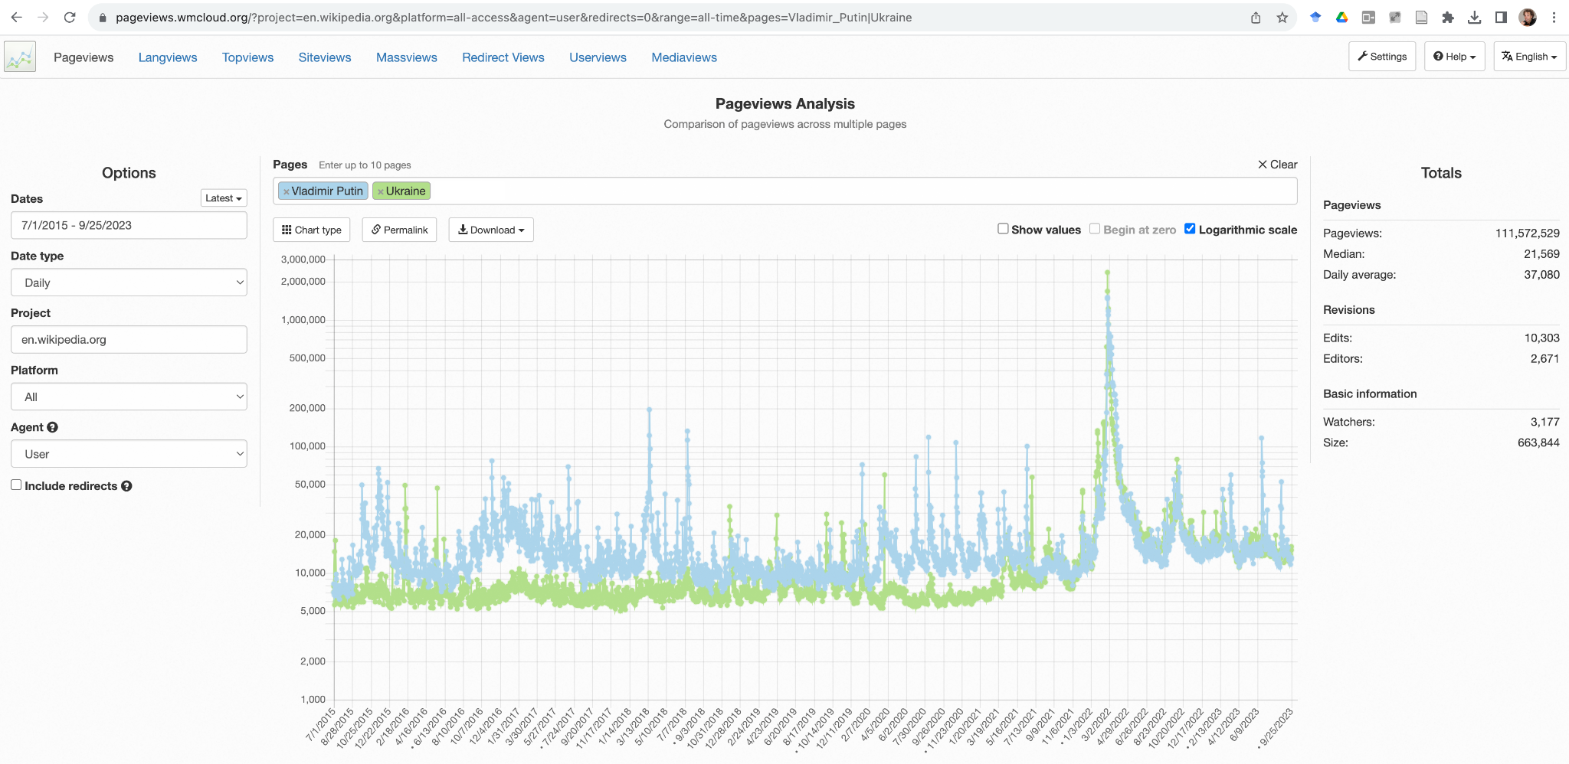
Wikipedia pageview logs
Notes:
Last 8 years
Putin’s article used to be more popular than Ukraine’s
Both spike in Feb 2022, when war starts
Since then, their destiny is locked: essentially the same shape and popularity
URL: https://pageviews.wmcloud.org/?project=en.wikipedia.org&platform=all-access&agent=user&redirects=0&range=all-time&pages=Vladimir_Putin|Ukraine

Slide 39
Crawling and processing webpages: HTML
Plenty of bulk-downloadable HTML data:
Common Crawl dataset, about 1.82 billion web pages -- huge!
(… but less than 0.1% of Google’s Web crawl, as of 2015)
145 TB, hosted on Amazon S3, also available for download
… but if you need a specific website: use a crawler/“spider”: Apache Nutch, Storm, Heritrix 3, Scrapy, etc. (or simply wget…)
Notes:
So far: data that someone else has spent a lot of time prepping for you (even nice GUI for wiki pageview stats)
Not always the case. Sometimes need to extract your own clean data from dirty raw data, e.g., HTML web pages
…

Slide 40
Useful HTML tools
Requests http://docs.python-requests.org/en/master/
An elegant and simple HTTP library for Python
Scrapy https://scrapy.org/
An open-source framework to build Web crawlers
Beautiful Soup http://www.crummy.com/software/BeautifulSoup/ A Python API for handling real HTML
Plain ol’ /regular/expres*ion/s…

Slide 41
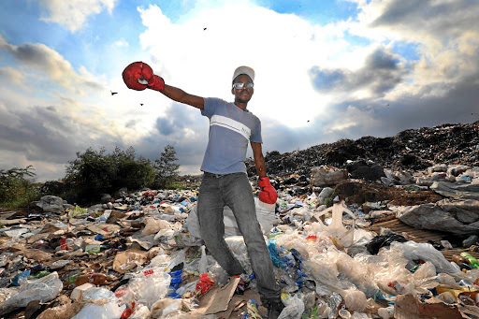
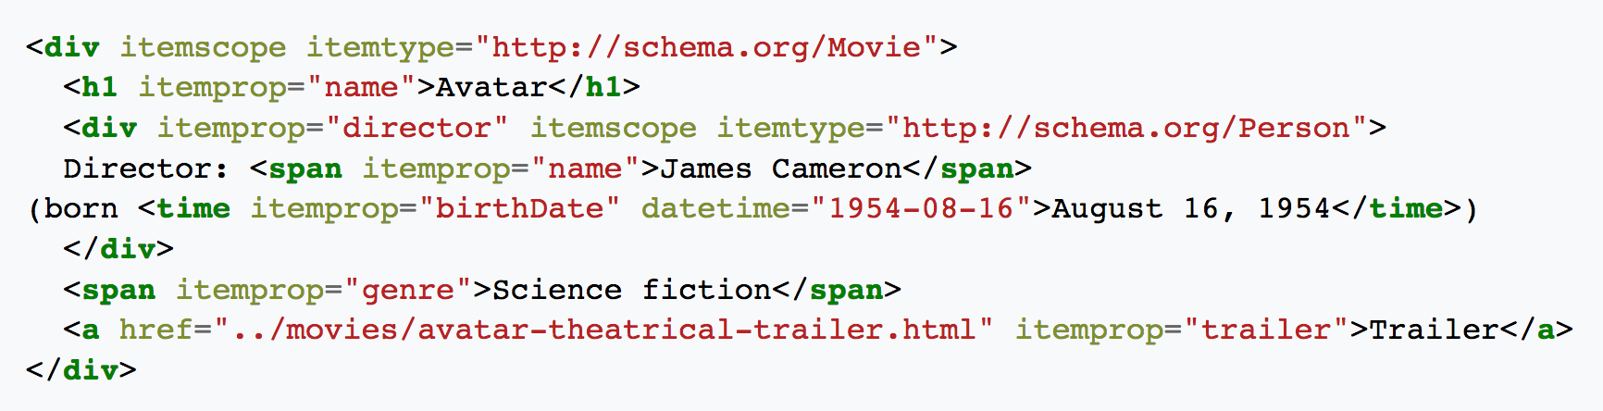
Schema.org: microformats for Web pages
Nuggets of structured information embedded in (semantically) unstructured HTML
Text as rendered by browser:
Avatar
Director: James Cameron (born August 16, 1954)
…
HTML under the hood:
Notes:
Working with HTML often feels like working with trash: every site different format; often ill-formatted
But sometimes you can find amazing things in trash (à la dumpster diving)
In this spirit, would like to draw your attention to Schema.org
…
Keep an open eye for such annotations when extracting data from HTML

Slide 42
Web services
Most large web sites today actively discourage “screen-scraping” to get their content
Instead: Web service APIs, for interoperable machine-to-machine interaction over a network
The preferred way to get data from online sources
Most common framework: REST
You request a URL from the server via HTTP
The server responds with a text file (e.g., JSON, XML, plain text)
Notes:
But a man gotta do what a man gotta do…

Slide 43
REST example
{
"user": {
"name": "Jane",
"gender": "female",
"location": {
"href": "http://www.example.org/us/ny/new_york",
"text": "New York"
}
}
}
← This resource is a description of a user named Jane
Requested by sending GET request for the resource’s URL, e.g., via curl: curl http://www.example.org/users/jane/
If users need to modify the resource, they GET it, modify it, and PUT it back
The href to the location resource allows savvy clients to get more information with another simple GET request
Implication: Clients cannot be too “thin”; need to understand resource formats!
Notes:
Imagine a website, example.org, with a REST API for providing information about its users
To request info about a user “Jane”, you would request a very specific URL, and the server would reply with a structured JSON object that contains info about Jane
HTTP request like those made by your Web browser, but response is different (JSON, not HTML)
…

Slide 44
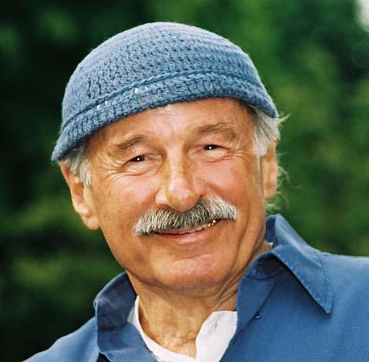

Joe Zawinul
I said, “What’s that?” and he said, “That’s jazz.” “How do you write that?” And he spelt it out. Somehow I saw my name in there, and I liked this word.
I said, “What’s that?” and he said, “That’s REST.” “How do you write that?” And he spelt it out. Somehow I saw my name in there, and I liked this word.
Robert West
[link]

Slide 45
Cooking with data
Part 2:
Data sources
Part 1:
Data models
Part 3:
Data wrangling

Slide 46
Working with raw data sucks
Data comes in all shapes and sizes – CSV files, PDFs, SQL dumps, .jpg, …
Different files have different formatting – Empty string or space instead of NULL, extra header rows, character encoding, …
“Dirty” data – Unwanted anomalies, duplicates

Slide 47
Raw data without thinking:
A recipe for disaster!
Notes:
(to stay within the cooking analogy)

Slide 48
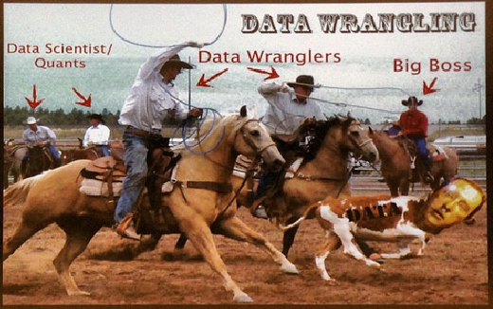
What is data wrangling?
Goal: extract and standardize the raw data
Combine multiple data sources
Clean data anomalies
Strategy: Combine automation with interactive visualizations to aid in cleaning
Notes:
To bring raw data in shape, we need to wrangle it (like you wrangle a young horse to break it in)
“Checks and balances”:
Automation to save you time and effort
Viz to see that you didn’t screw up

Slide 49
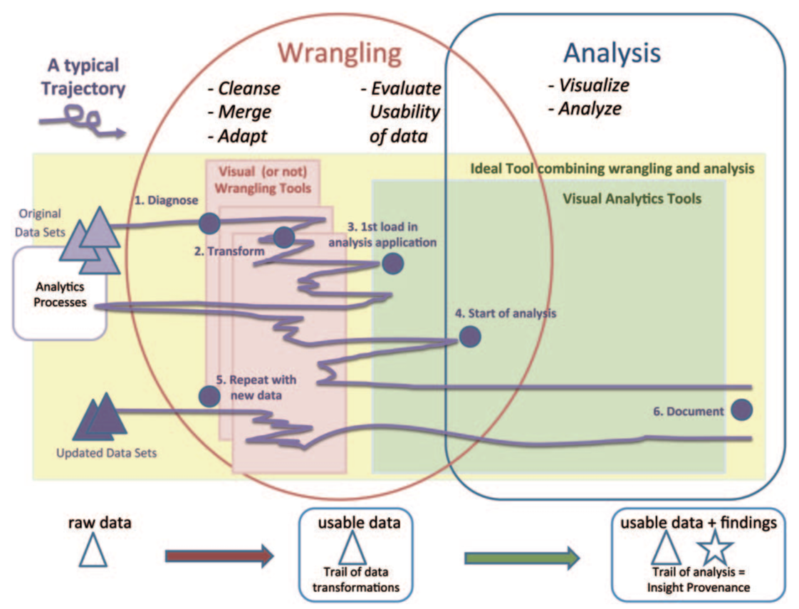
Wrangling takes between 50% and 80% of your time…
[Source]
Notes:
Data wrangling is important for a data scientist: 50-80% of time :(
Schematically: Left: raw data; right: insights from analysis (want to get from left to right)
Horrible plot to put in words -- but that’s exactly the point
it’s extremely ad-hoc
there’s no perfect recipe
You win some, you lose some
Need to use common sense!
(last year’s feedback from a student via form: “Bob didn’t show us how exactly DW is done…”)

Slide 50


Types of data problems
Missing data
Incorrect data
Inconsistent representations of the same data
About 75% of data problems require human intervention (e.g., experts, crowdsourcing, etc.)
Tradeoff between cleaning data vs. over-sanitizing data
link

Slide 51

“Dirty data” horror stories
“Dear Idiot” letter
17,000 men are pregnant
As the crow flies
CHF 10,000 compute-cluster bill
[Source]
Notes:
“For your own perusal at home”
Just tell CHF 10,000 anecdote?

Slide 52
Diagnosing data problems
Visualizations and basic stats can convey issues in “raw” data
Different representations highlight different types of issues:
Outliers often stand out in the right kind of plot
Missing data will cause gaps or zero values in the right kind of plot
Becomes increasingly difficult as data gets larger
Sampling to the rescue!
Notes:
HW1!

Slide 53
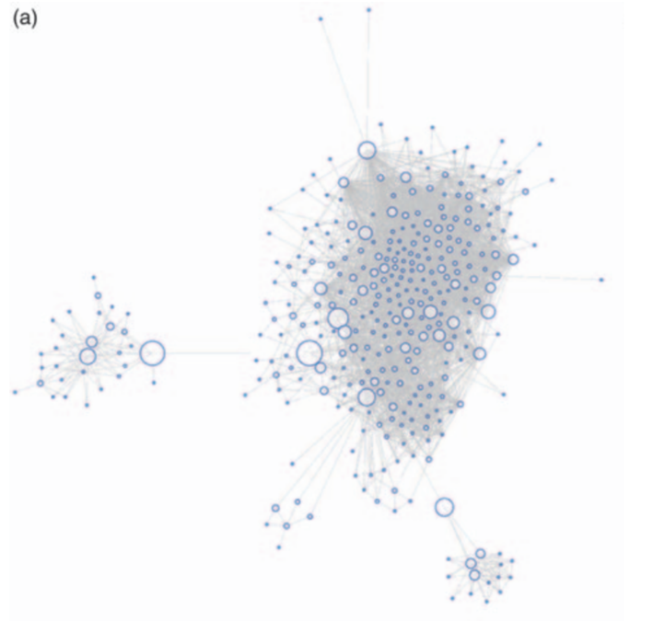
Facebook graph
Notes:
For the youngsters: FB was a social network where you could become virtual friends w/ someone

Slide 54
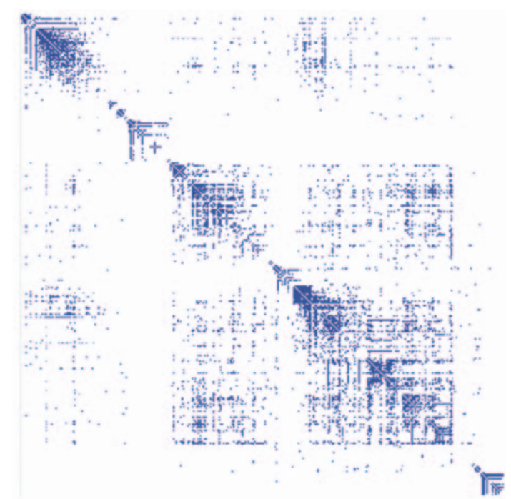
Matrix view (1)
Automatic permutation of rows and columns to highlight patterns of connectivity
Notes:
Explain rows and columns
Ask: why is the matrix symmetric?

Slide 55
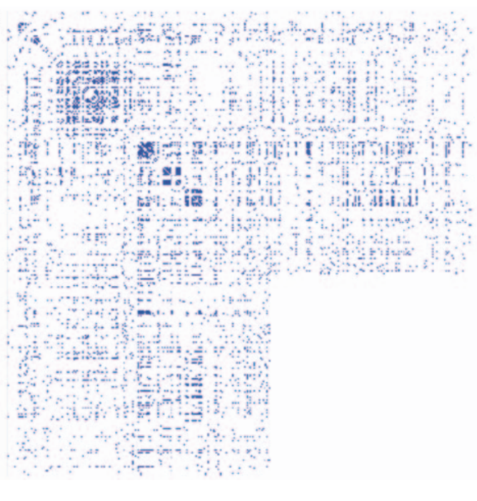
Matrix view (2)
Rows and columns sorted in the order in which data was retrieved via the Facebook API
Can you guess what’s going on here?
Notes:
More info: http://vis.stanford.edu/files/2011-DataWrangling-IVJ.pdf

Slide 56
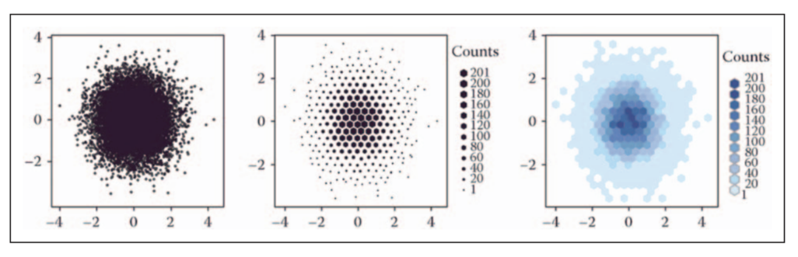
Viz at scale? Careful!
Notes:
Hexagon vs. square
Color discontinuity: makes spotting missing data easier

Slide 57
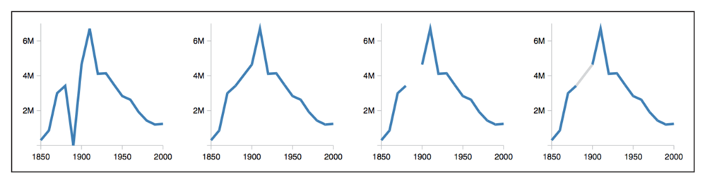
Dealing with missing data
U.S. census counts of people working as ‘‘farm laborers’’; values from 1890 are missing due to records being burned in a fire
Set values to zero?
Interpolate based on existing data?
Omit missing data?
Knowledge about domain and data collection should drive your choice!
Notes:
…
E.g., “0 b/c records burned” very different from “0 b/c farms burned”
(Ashton’s version: https://mail.google.com/mail/u/0/#inbox/FMfcgzGljvRncXFszKbgqtLCKcNhGnPC)

Slide 58
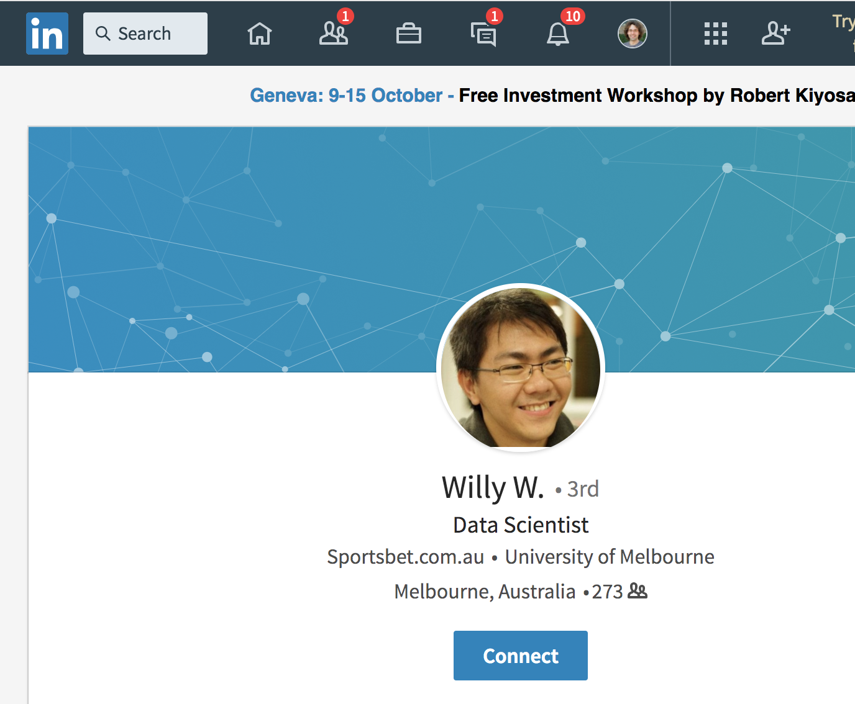
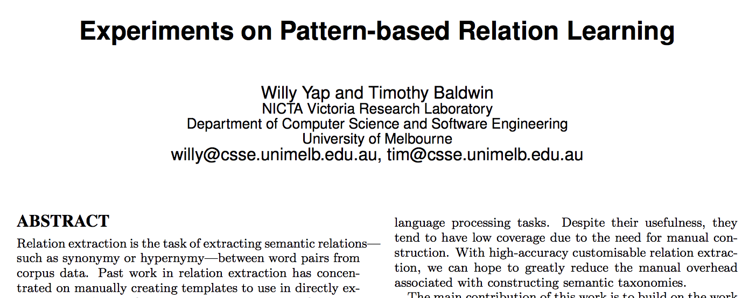
Inconsistent data: “My name is Willy”
First name | Last name
Willy | NULL
... | ...
Notes:
I’m amazed how I even managed to find Willy via Google when making these slides
Luckily, Uni Melbourne is ok with first names for email addresses

Slide 59
Before you start analyzing your data
“Do I have missing data?” “If data were missing, how could I know?”
“Do I have corrupted data?” (May arise from measurement errors, processing bugs, etc.)
Parse/transform data into appropriate format for your specific analysis (see “Part 1: Data models”)
Don’t be surprised if you need to come back to this stage!
Notes:
This slide might be a “duh” moment, but people often forget these steps!

Slide 60
Desiderata
It’s always ideal if you can put your hands on the code/documentation about the dataset you are analyzing (provenance)
It’s always ideal if the provided data format is nicely parseable (otherwise you need regexes, or maybe even pay humans)

Slide 61
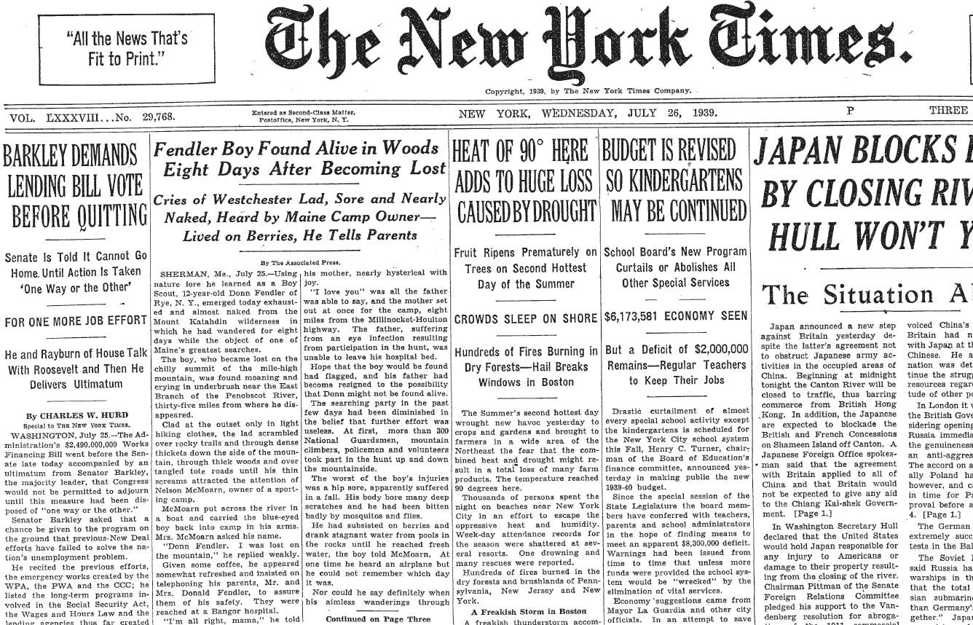

Highly non-parseable data
Entire NY Times archive (since 1851) digitized as of 2015
Notes:
State-of-the-art OCR can’t do it
But humans can, so use it as a test of whether user is a human
(CAPTCHA = Completely Automated Public Turing test to tell Computers and Humans Apart)
Beauty: two birds with one stone: test + data
And when the system is compromised, everyone wins: OCR++
EXPLAIN:
Two words, one with known ground truth

Slide 62
Feedback
Give us feedback on this lecture here: https://go.epfl.ch/ada2023-lec2-feedback
Feedback form available for each lecture and lab session
What did you (not) like about this lecture?
What was (not) well explained?
On what would you like more (fewer) details?
Is it nicer to follow the lecture online or offline?
…

Slide 63
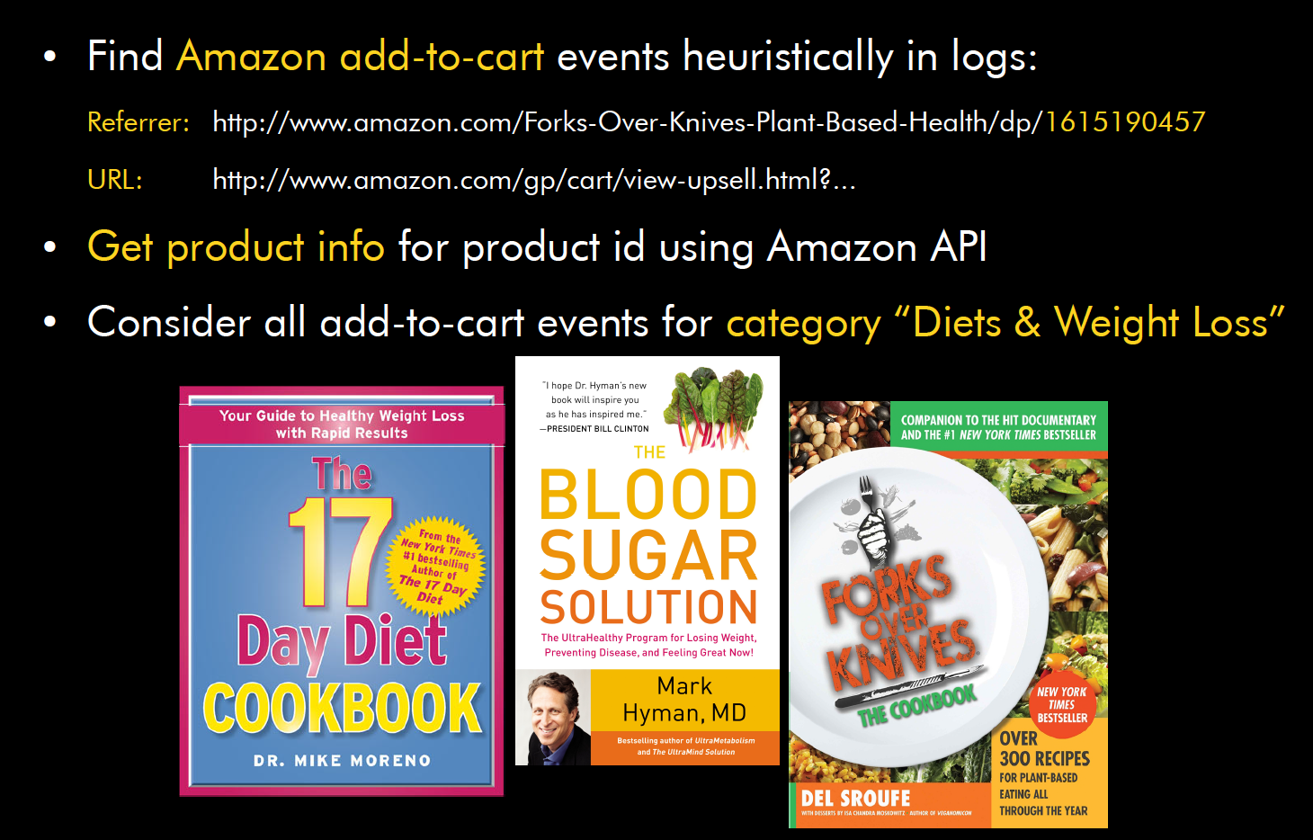
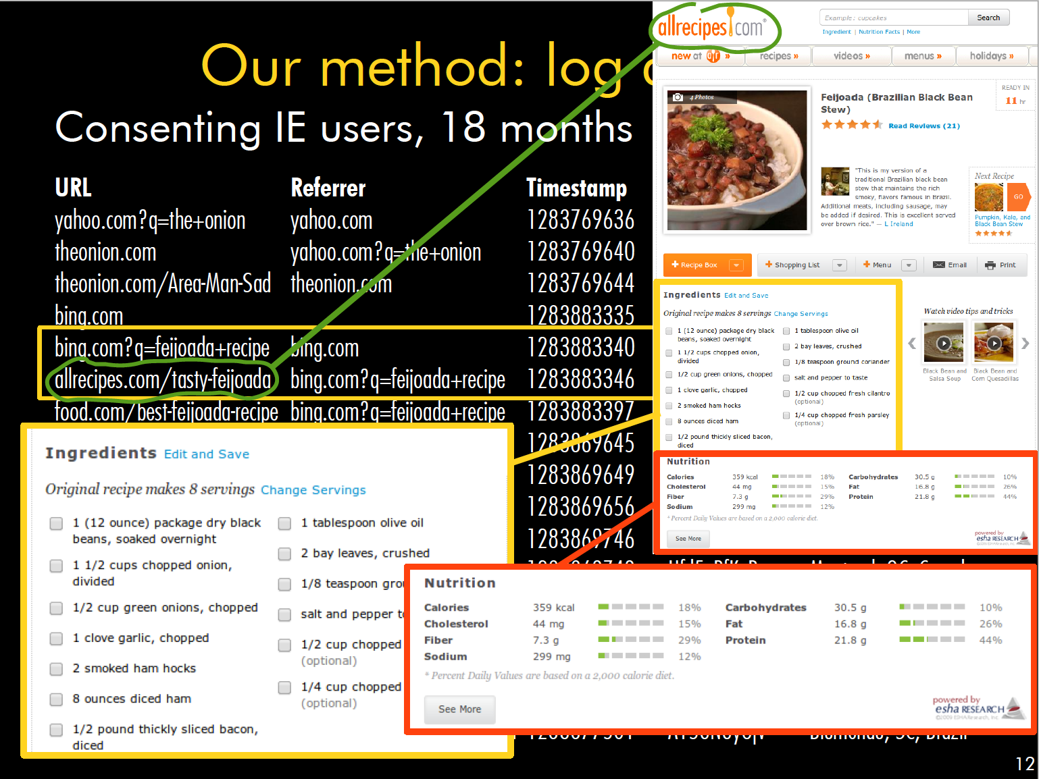
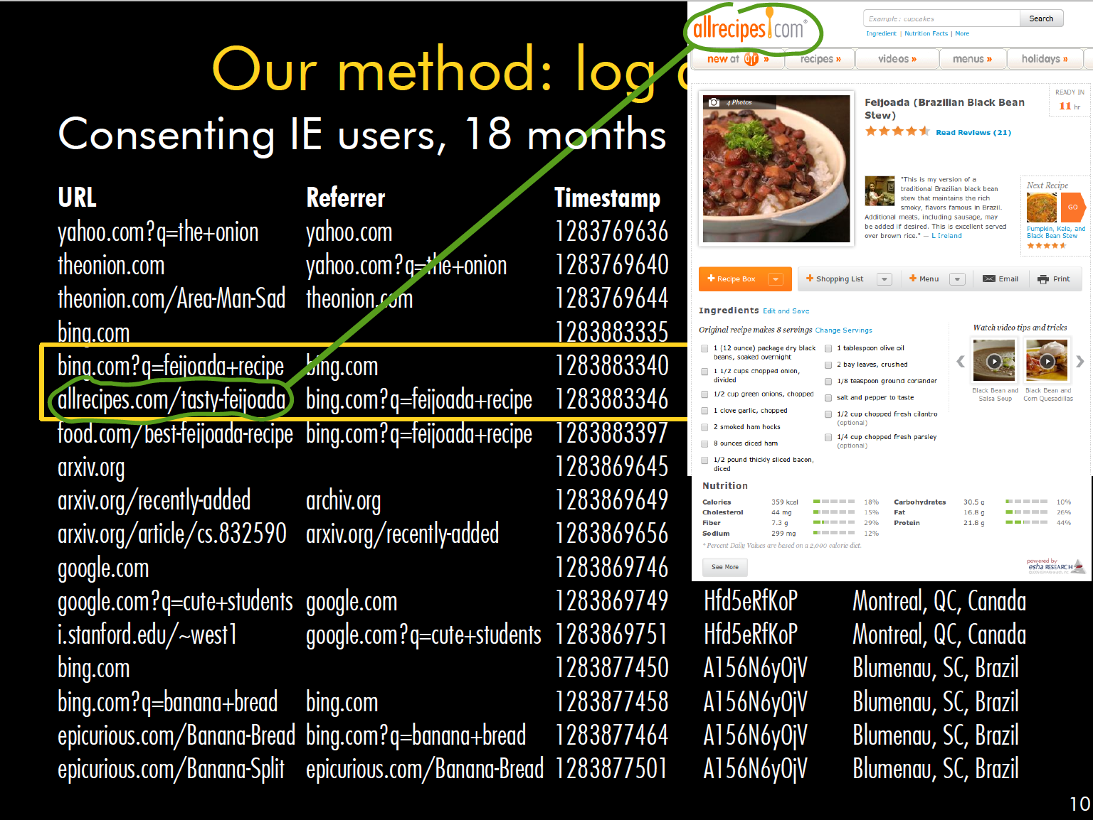
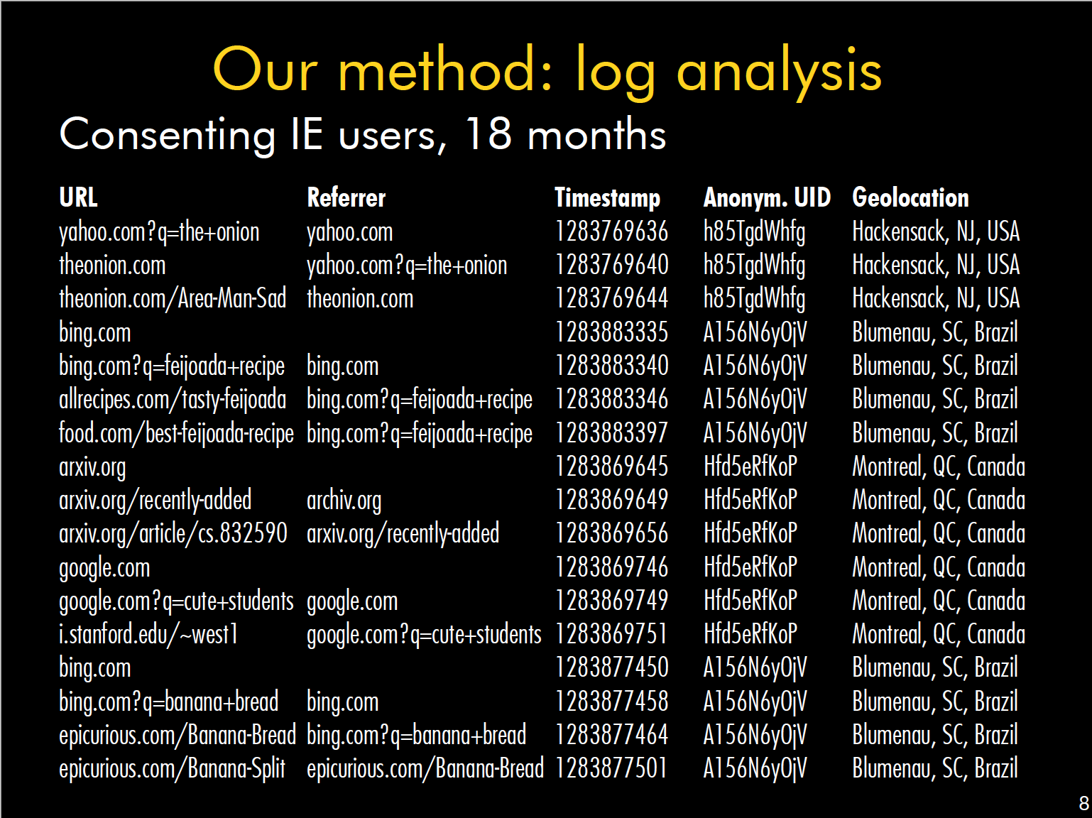
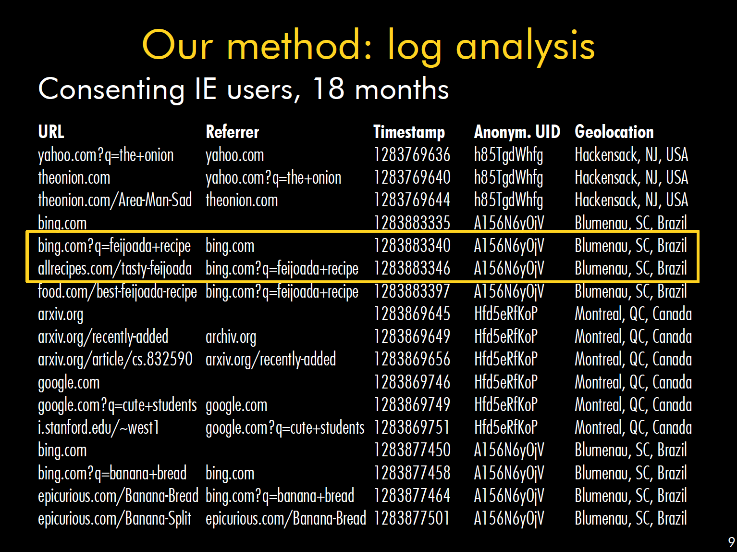
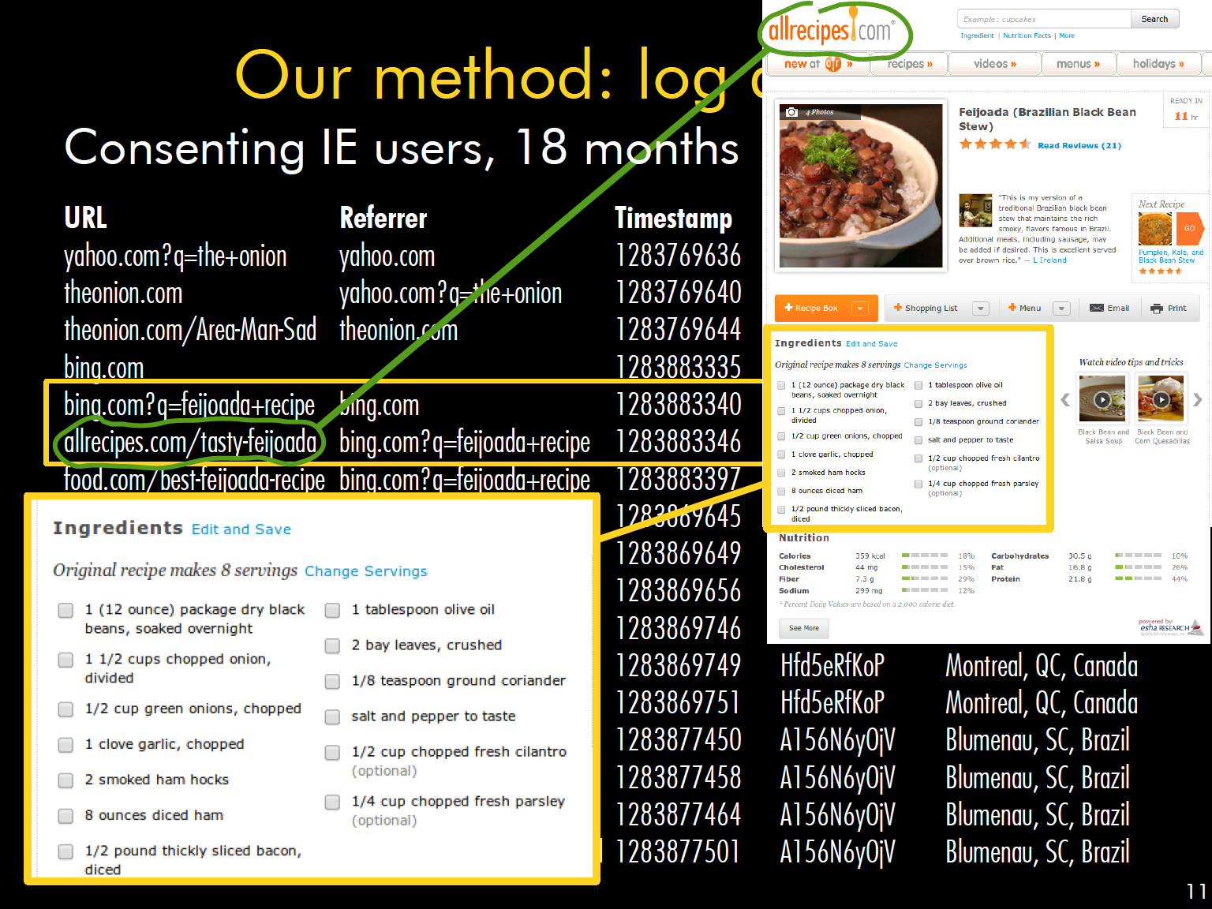

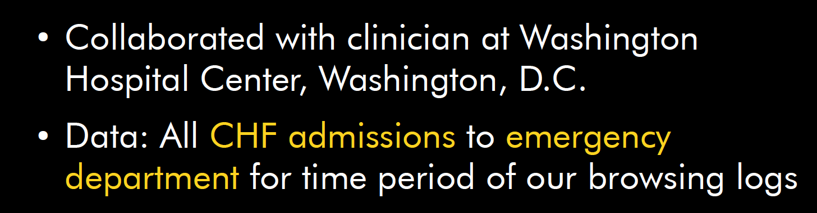
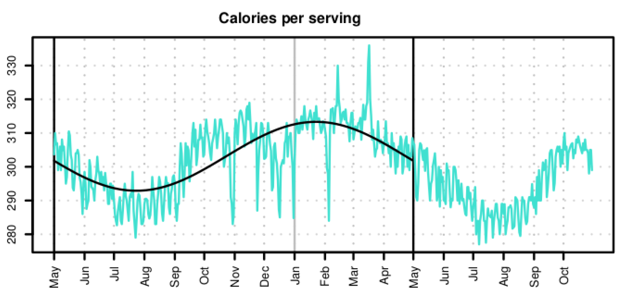
Example from Bob’s research (AD 2013)
Q: What do people eat when and where?
Paper with results and plots

